Slide 1
Capstone Project
Battle of Neighborhoods – opening a restaurant in mumbai

Slide 2
INTRODUCTION
Mumbai is the financial capital of India, It consists of a large variety of venues under different categories.
The objective of this project is to find a suitable neighbourhood to attract customers and where there is a scarcity of restaurants.
Target Audience
One has recently moved to Mumbai to start a new venture.
Ones who are in Mumbai and looking to expand in to restaurant business.

Slide 3
DATA SOURCE
The data used in this project is from a csv file found online which contains the data related to all neighbourhoods in Mumbai.
We will use Geolocator to map out coordinates of these neighborhoods and accordingly plot them on city map.
To explore out venues in these neighbourhoods, Foursqure API is used to fetch venues within a certain radius in each neighbourhood.
The API returns a JSON file which is converted into pandas dataframe to proceed with further analysis.

Slide 4
METHODOLOGY
Information for venues in each neighbourhood is obtained via foursquare API.
Geolocator Nomanitim is used to find geospatial data for each address of neighbourhood which acts as input to Foursqure API.
The result is a JSON which is then converted in pandas dataframe.
Folium is used to plot the neighbourhoods on Map for holistic view of clusters.
To find clusters we will use Kmeans clustering algorithm to identify clusters types of each neighbourhood.
Based on the results we will finalise the cluster which will be suitable for a restaurant.

Slide 5
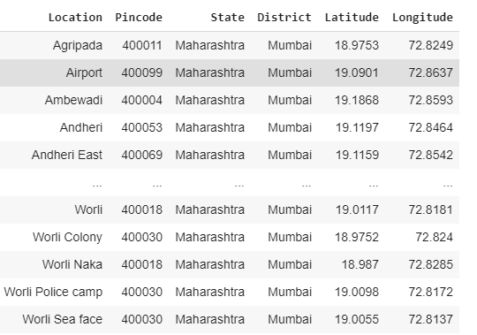
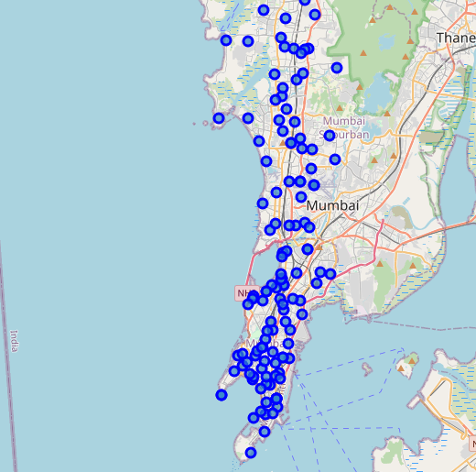
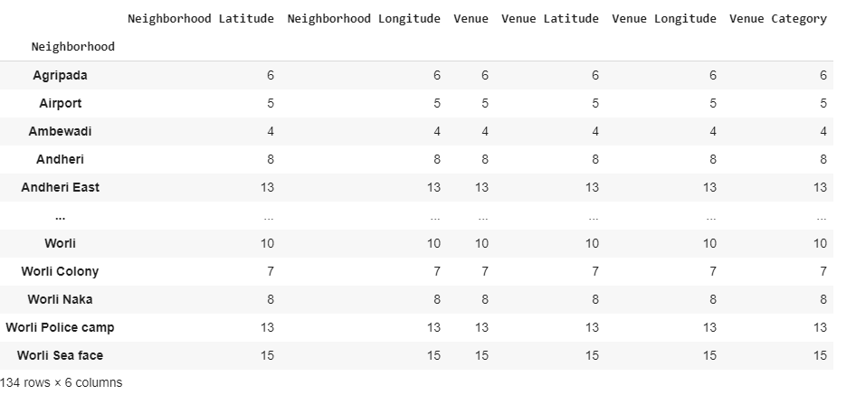
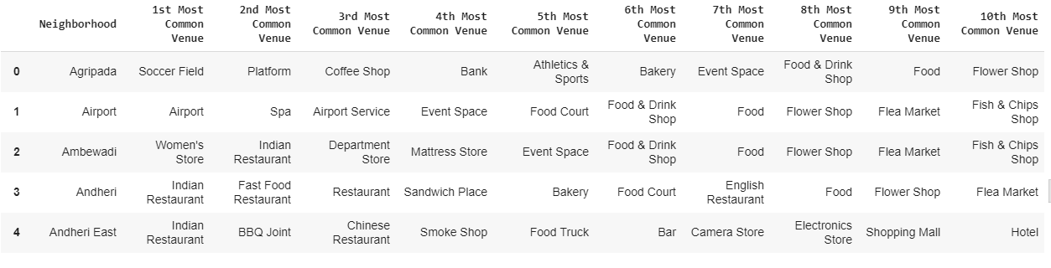
EXPLORATORY DATA ANALYSIS
Latitudes and Longitudes mapped out via geolocator
Folium to plot these neighbourhoods
Grouping to identify no. of venues in each neighbourhood.
Most Common venues identified in Each Neighbourhood

Slide 6
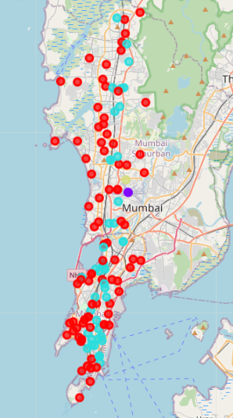
RESULTS
4 Clusters Identified

Slide 7
DISCUSSION AND CONCLUSION
According to results we observed majority of restaurants identified are Indian restaurants, thereby there is a huge scope in other Cruisines.
Mumbai has a good night life having Bars and Clubs.
Based on the above clusters, Cluster 2 & 3 seems to be a reasonable choice for a restaurant as there are less fast food restaurants in 3 that area and 2 is dominated by Indian Restaurants majorly.
These results have limitations – Foursquare is not much popular in India, therby we might have lost some data.

Slide 8
Thank You !

